Slide 1
Practical GUI Testing of Android Applications via Model Abstraction and Refinement ICSE 2019
Tianxiao Gu, Chengnian Sun, Xiaoxing Ma, Chun Cao, Chang Xu
Yuan Yao, Qirun Zhang, Jian Lu, Zhendong Su
吴家行 2020213991
黄城恩 2020270152
Notes:
大家好，今天我们为大家介绍的一篇文章是ICSE2019的一篇文章，这篇文章主要介绍了一种基于模型抽象和细化的安卓GUI测试的方法。我是吴家行，他是黄城恩，我将会对本文的相关背景知识和针对本文的一些看法进行介绍，城恩将会对本文提出的方法和实验部分进行介绍。

Slide 2

Background
Mobile application (app) testing heavily involves human effort
Not only time-consuming but also error-prone.
Automated GUI Testing for Android Apps
Generate purely random events. (e.g., Monkey, a GUI fuzzing tool developed by Google)
Generated events are low-level, which complicates reproduction and debugging.
Model-based GUI Testing.
Finite state machine
Each state has a set of model actions, and each transition between states is labeled with a model action of the source state.
Notes:
首先，介绍一下相关背景,目前移动应用的测试需要很大的人力成本，测试人员需要编写测试代码，模拟各种界面上行为的发生，执行不同的功能。这种方式费时，而且很容易出错，当界面改变时，测试人员还要对测试的脚本进行修改。
为了解决上面的问题，好多关于自动化的GUI测试的技术开始出现。比如，Monkey是谷歌开发的一款用于GUI模糊测试的工具，可以随机生成一些操作事件来对软件进行测试，但是这种方法也有一些缺点，这种方法不能保证覆盖所有的GUI,自动生成的事件往往是低级而且特别长的，会使重构、调试变得更加复杂。
还有一种安卓GUI测试的方法是基于模型的方法，采用的模型往往是一个有限的状态机，每个状态下都有一组模型动作，状态间的转移用模型动作来标识。在实际测试中，测试工具往往将GUI的动作抽象成模型动作，将GUI的视图抽象成模型状态，这样就将GUI的测试转化成为了一种测试模型。

Slide 3
Beneﬁts of Model-based GUI Testing
Guide the exploitation of an app
Generates input sequences composed of high-level model actions rather than low-level events
A proper abstraction can be applied to the model
overly ﬁne-grained -> state explosion
overly coarse-grained -> difﬁcult to replay model action sequences
APE - a new, practical model-based automated GUI testing technique for Android apps via effective dynamic model abstraction.
Notes:
对于GUI测试，模型有以下的优点，
第一，模型可以用于引导应用的开发。测试工具可以使用特殊的引导去遍历模型，系统的生成动作序列，然后通过重演动作序列来对app进行测试。
第二，基于模型的测试工具生成的输入序列更高级。
第三，模型可以进行抽象化，可以减少GUI动作的冗余。通过抽象，好多类似的GUI动作可以归为一个模型动作，测试只针对一个模型动作进行测试即可。模型动作的映射可以说的模型抽象最关键的一个步骤，如果映射的过于细致，那么会产生大量的动作，导致“状态爆炸”，反之，如果映射的过于粗糙，那么不同的GUI动作可能会被归为一个模型动作，导致GUI动作不能被重演。
本文通过有效动态模型抽象，提出了一种基于模型的全自动GUI测试方法-APE。APE首先赋予模型一个默认的抽象规则，用来初始化模型，这种抽象可能是没有用的，但随着测试的进行，APE可以逐渐优化模型，寻找更合适的抽象规则，有效的权衡模型的大小和模型的精度。

Slide 4
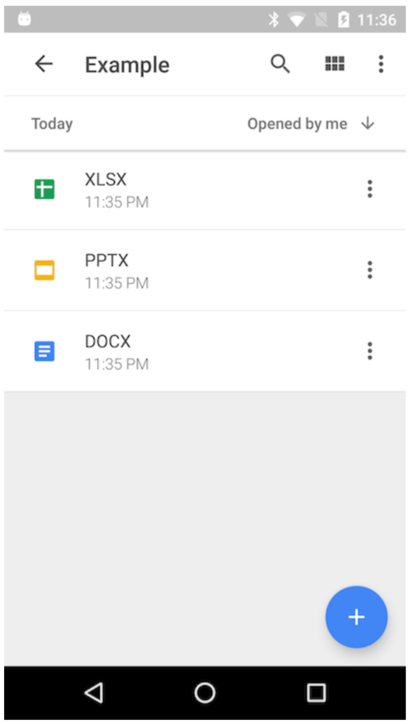
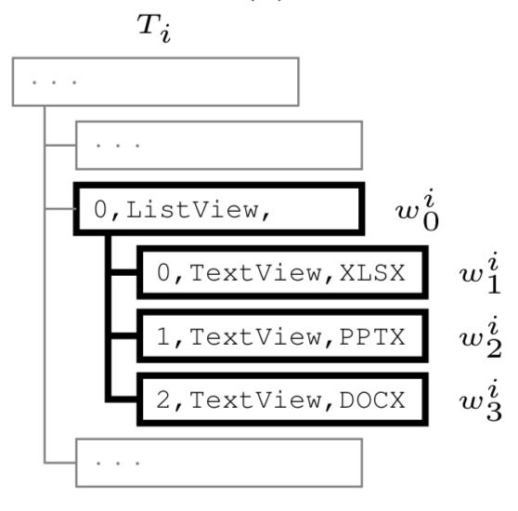
GUI of Android Apps
In an Android app, an activity is a composition of widgets.
A widget has four categories of attributes describing its type (e.g., class), appearance (e.g., text), functionalities (e.g., clickable and scrollable), and the designated order among sibling widgets (i.e., index).
Each attribute is a key-value pair.
e.g., an index attribute whose value is 0 can be denoted by i = 0.
GUI
GUI Tree/State
Notes:
安卓app中，一个活动是由许多部件组成的。这些部件组成的结构是树形结构，我们称之为GUI树。一个部件可以是一个按钮、一个输入框或者是一个layout构成的容器，他可以产生被点击或者被滑动的动作。部件有四类属性，分别来描述它的类型、外观、功能、同级widget的顺序，每个属性都是个键值对，我们用i,表示index属性，那么i=0就表示这个部件的index值为0。一个GUI树是一个有根有序的树，每一个节点代表一个部件，每个部件包含一些属性。现在的安卓SDK工具可以支持获取一个活动的GUI树。

Slide 5
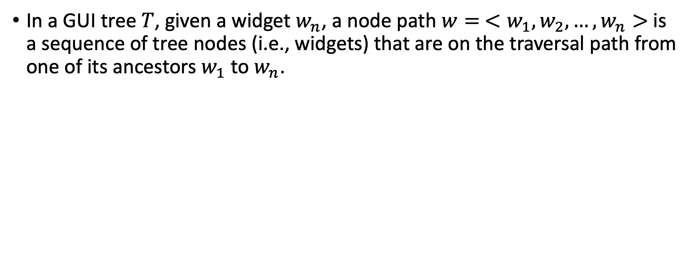
Attribute Path
In a GUI tree $T$, given a widget $w_{n}$, a node path $w= <w_{1}, w_{2},…,w_{n}>$is a sequence of tree nodes (i.e., widgets) that are on the traversal path from one of its ancestors $w_{1}$ to $w_{n}$.
Notes:
下面介绍一下属性路径的相关概念，在一个GUI树中，给定部件$w_{n}$，节点路径是从$w_{1}$到$w_{n}$的一个遍历路径，和文件系统中路径的概念类似，如果$w_{1}$是GUI树的根节点，则$w$是一个绝对路径，如果$w_{1}$不是GUI树的根节点，则$w$是一个相对路径。绝对路径可以唯一标识树中的一个部件。

Slide 6
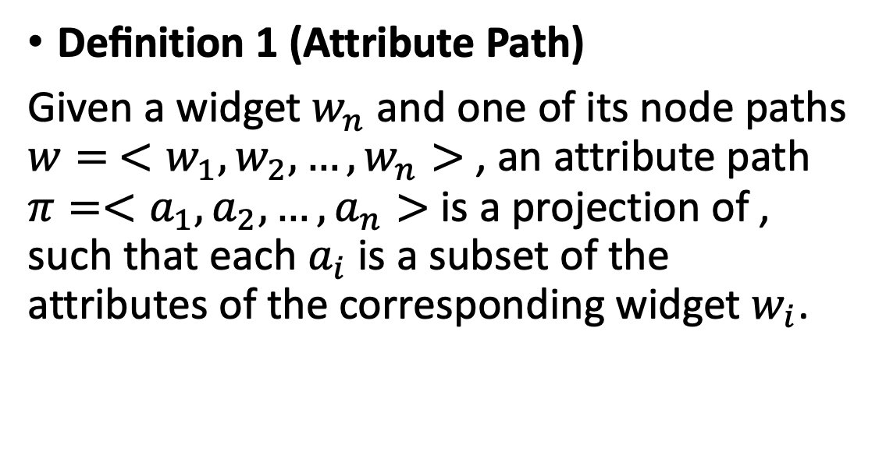
Attribute Path
Deﬁnition 1 (Attribute Path)
Given a widget $w_{n}$ and one of its node paths $w= <w_{1}, w_{2},…,w_{n}>$, an attribute path $π=<a_{1},a_{2},…,a_{n}>$ is a projection of , such that each $a_{i}$ is a subset of the attributes of the corresponding widget $w_{i}$.
Notes:
第一个定义是，属性路径的定义，给定一个部件$w_{n}$和它的节点路径​$w$，则​的属性路径为​$π$，其中$a_{i}$是部件$w_{i}$​的属性子集。

Slide 7
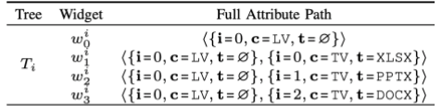
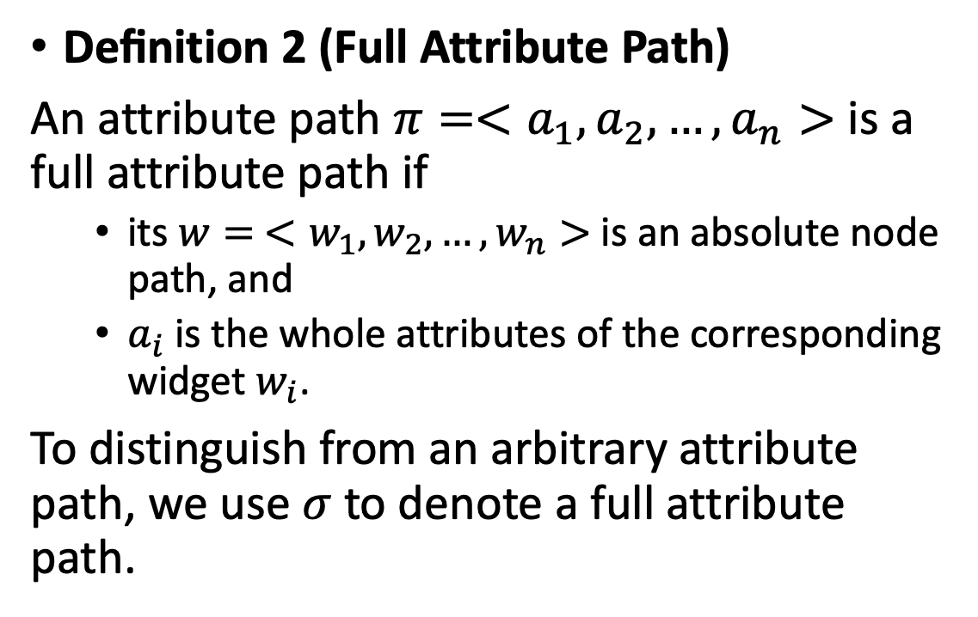
Attribute Path
Deﬁnition 2 (Full Attribute Path)
An attribute path $π=<a_{1},a_{2},…,a_{n}>$ is a full attribute path if
its $w= <w_{1}, w_{2},…,w_{n}>$ is an absolute node path, and
$a_{i}$ is the whole attributes of the corresponding widget $w_{i}$.
To distinguish from an arbitrary attribute path, we use $σ$ to denote a full attribute path.
Notes:
第二个定义是，全属性路径的定义，如果一个属性路径满足对应的节点路径$w$​是绝对路径,并且$a_{i}$是部件$w_{i}$​的所有属性，那么我们称这个属性路径是全属性路径，记做​$σ$
这样，一个部件就可以用一个全属性路径唯一标识，全属性路径中的部件顺序反映了部件的层次结构，每个部件中的索引属性决定了部件和兄弟节点的唯一位置，因此，一个GUI树等同于所有全属性路径的集合，如下表所示。

Slide 8
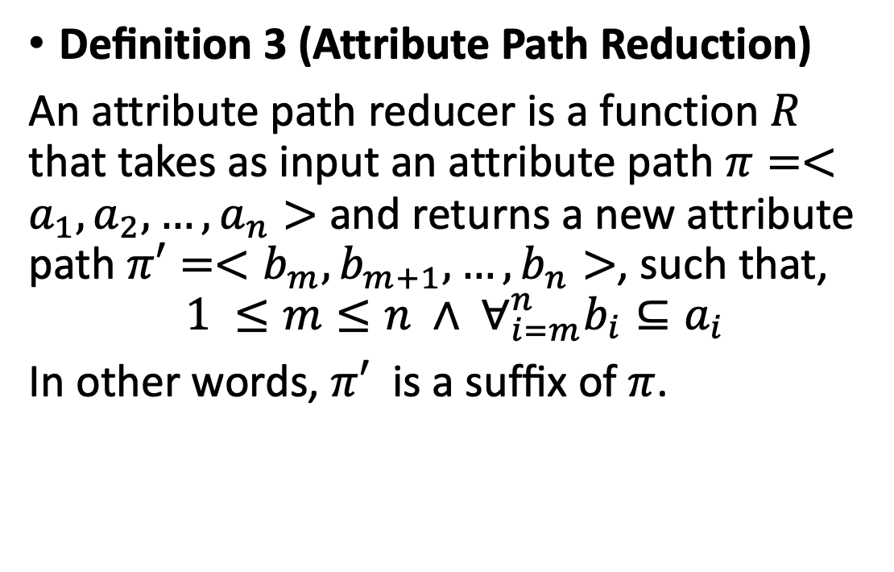
Attribute Path
Deﬁnition 3 (Attribute Path Reduction)
An attribute path reducer is a function $R$ that takes as input an attribute path $π=<a_{1},a_{2},…,a_{n}>$ and returns a new attribute path $π′=<b_{m},b_{m+1},…,b_{n}>$, such that,
$$1 ≤m≤n ∧ ∀_{i=m}^{n}b_{i}⊆a_{i}$$
In other words, $π′$ is a sufﬁx of $π$.
Notes:
第三个定义是属性路径简化的定义，属性路径简化函数​$R$以属性路径​$π$作为输入，返回一个新的属性路径$π′$​。 其中$1 ≤m≤n$，​且对于任意$m ≤i≤n$​都有$b_{i}是a_{i}的子集$​。也就是说, $π′$​是​$π$的后缀，$π′$​中的每个元素都是​$π$对应元素的子集

Slide 9
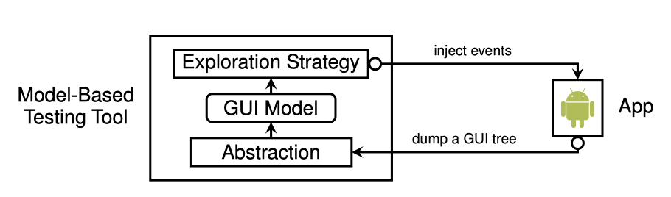
Model-Based Android GUI Testing
During each iteration, the testing tool
(1) obtains the current GUI tree of the app,
(2) identiﬁes an existing, corresponding state, or creates a new state for this GUI tree, and
(3) picks a model action and determines a concrete GUI action to interact with the app.
Notes:
下面介绍一下基于模型的安卓GUI测试方法，图中展示了典型的基于模型的GUI测试流程，测试工具与应用软件迭代交互。刚开始时，测试工具的模型是一个空的状态机，随着每次迭代，测试工具做了如下几件事情：
首先获取了应用软件当前的GUI树
然后识别已经存在的状态，并创建新的状态
最后选择一个模型动作，确定和app交互的GUI动作
基于模型的GUI测试工具的目的在于发现更多的部件，并在已经发现的部件中测试他们的交互过程，现在的安卓应用界面中部件数量很庞大，需要将一些相同的模型动作进行抽象，以减少搜索的空间。

Slide 10
State Abstraction
State abstraction refers to the procedure that identiﬁes equivalent GUI trees and actions, and maps them to the same state and the same model action, respectively.
State abstraction determines two GUI actions as equivalent if
they have the same action type and,
their full attribute paths can be reduced to the same attribute path π by removing irrelevant attributes under certain reduction rules.
State abstraction determines two GUI trees as equivalent if all of their GUI actions can be reduced to the same set of attribute paths.
Notes:
什么是状态抽象呢？将等价的GUI树映射到同一个模型状态的过程&将等价的GUI动作映射到同一个模型动作的过程，都被成为状态抽象。
对于模型动作，如果GUI动作类型相同而且全属性路径可以通过一定的缩减规则去除一些不相关属性，缩减为相同的属性路径π，那么GUI动作被认为是等价的。
对于模型状态，如果包含的所有的GUI动作可以减为相同的属性路径的集合，那么GUI被认为是等价的。

Slide 11
An Illustrative Example
GUI State
GUI
Model State
X
?
P
W
We need a model that sees there are three different widgets in the list.
Notes:
这里我们举个例子，这是谷歌云盘app，在它的列表中有三个文件，分别是word, powerpoint和excel文件。点击这些项目，应用程序转换到新的状态。 我们希望能够将GUI状态抽象为模型状态，从而指导测试工具为三种不同的GUI状态单击三个文件。那么我们该如何对这个进行建模呢?

Slide 12
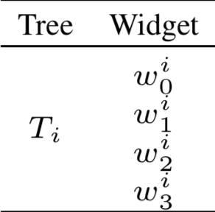
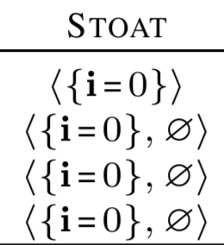
Stoat
Guided, Stochastic Model-based GUI Testing of Android Apps (FSE'2017)
We’ll see only one model widget in the list and it can lead to three different target states (non-deterministic transition)
Too coarse-grained
GUI State
Model State
GUI
Tree
Stoat abstracts the widget with its index (among its siblings) and cares nothing for items in a ListView
Notes:
在基于模型的测试工作之一Stoat只保留了每个小部件建模的index属性 显然，listview中的三个项目被抽象为相同的模型小部件，这意味着测试工具对于三个不同的文件 将看到相同的模型，这种做法粒度过粗。

Slide 13
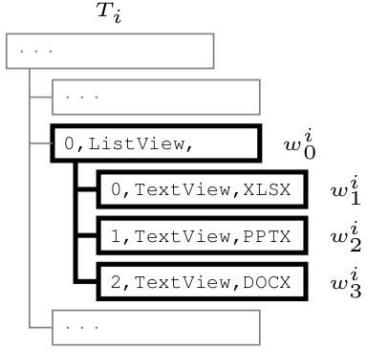
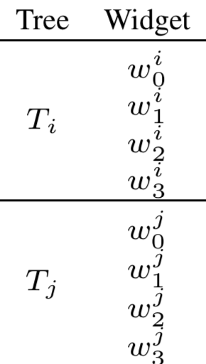
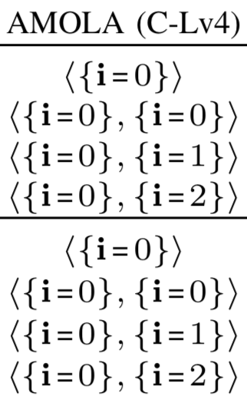
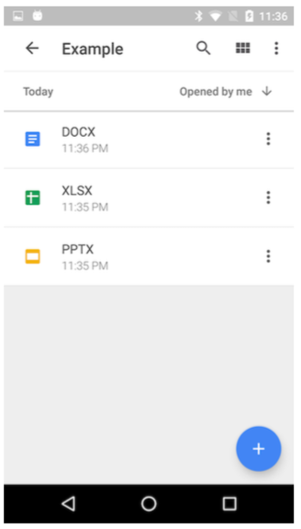

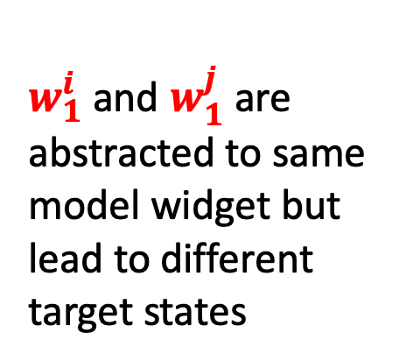
AMOLA(C-Lv4)
Automated Model-Based Android GUI Testing using Multi-Level GUI Comparison Criteria (ASE 2016)
AMOLA C-Lv4 abstracts the widget with its index (among its siblings) including items in a ListView
$w_{1}^{i}$ and $w_{1}^{j}$ are abstracted to same model widget but lead to different target states
Still too coarse-grained
Different GUI states map to a same model state
Notes:
AMOLA(C-Lv4)保留了所有组件的index属性，可以在同一个GUI中，区分出word,excel和powerpoint，而不同GUI也会出现问题，会将不同的部件识别成同一个部件。

Slide 14
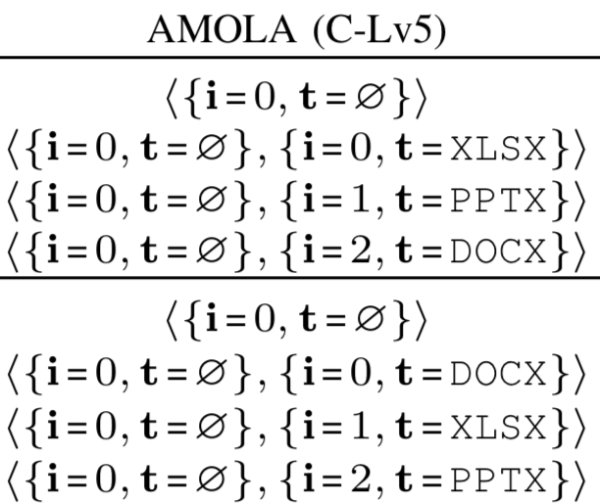

AMOLA(C-Lv5)
AMOLA C-Lv5 Considering widget text attribute additionally
and treats $w_{1}^{i}$ and $w_{3}^{j}$ differently
Too fine-grained abstraction (T_{i} T_{j} are different model states) to generate too many model states
Permutation
Notes:
AMOLA(C-Lv5)更加细化保留了所有组件的index和text属性，区分出word,excel和powerpoint，但是他的方法粒度过细，导致这两个部件明明是同一个，但是属性路径是不同的。

Slide 15
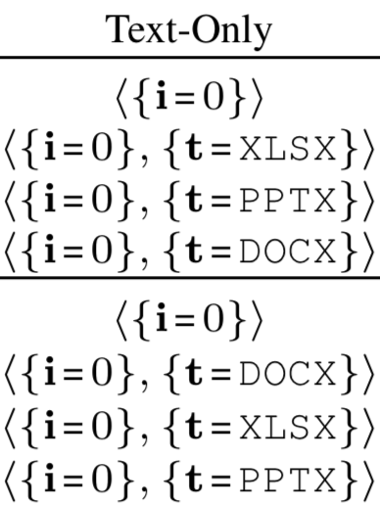
For this illustrative example
Take the text attribute instead of the index for ListView items
Appropriate abstraction for the GUI tree
But how can a testing tool know this?
Notes:
最合适的其实这种抽象建模，[切]对于ListView的子部件抽象的时候只保留了text属性，然而，目前已有的工具无一可以做到这种抽象，而本文提出的动态抽象的方法做到了。下面城恩会对本文的创新方法进行详细的介绍。

Slide 16
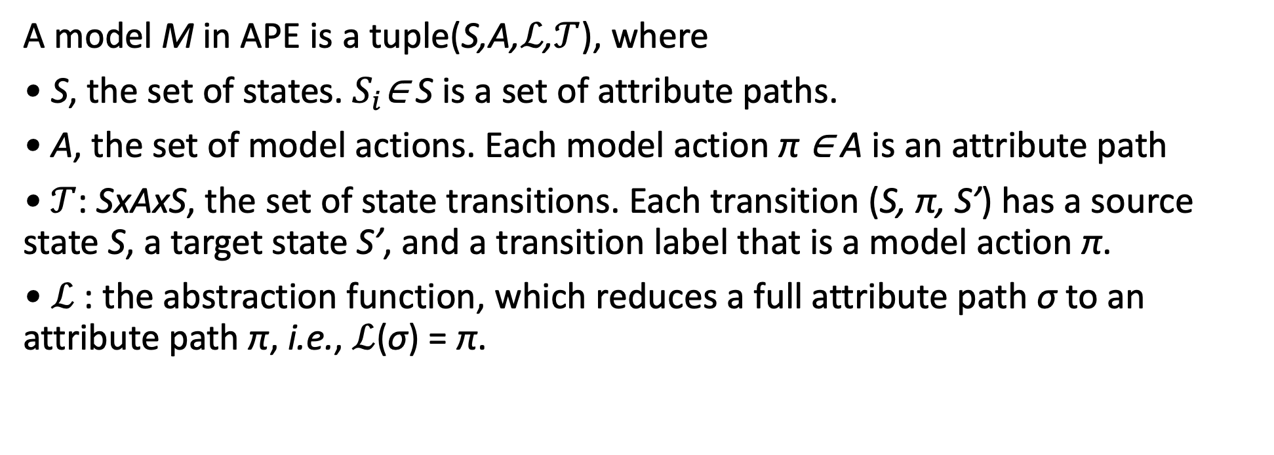
Model definition
A model M in APE is a tuple(S,A,$ℒ$,$𝒯$), where
• S, the set of states. $S_{i}$∈ S is a set of attribute paths.
• A, the set of model actions. Each model action π ∈ A is an attribute path
•$𝒯$: SxAxS, the set of state transitions. Each transition (S, π, S’) has a source state S, a target state S’, and a transition label that is a model action π.
• $ℒ$ : the abstraction function, which reduces a full attribute path σ to an attribute path π, i.e., $ℒ$(σ) = π.
Notes:
derive two variants from L, LL and LL 简化函数
Big L : Given a GUI tree T (i.e., a set of full attribute paths), LL can be used to find its corresponding state S,
Small L : And given a GUI transition (T, σ, T), LL can be used to find its corresponding state transition (S, π, S)
一個 state 對應到一個 GUI tree 相當於 每一個 Pi 都代表某一個小部件

Slide 17
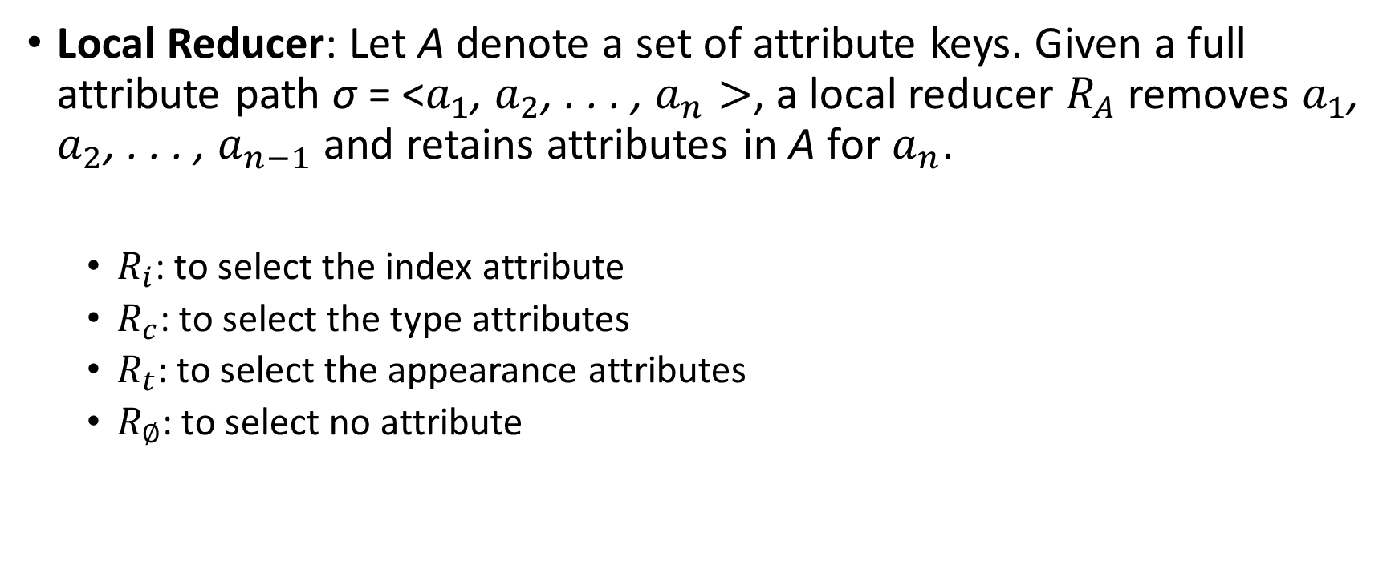
Decision Tree (Dynamic Abstraction Functions)
Local Reducer: Let A denote a set of attribute keys. Given a full attribute path σ = <$a_{1}$, $a_{2}$, . . . , $a_{n}>$, a local reducer $R_{A}$ removes $a_{1}$, $a_{2}$, . . . , $a_{n−1}$ and retains attributes in A for $a_{n}$.
$R_{i}$: to select the index attribute
$R_{c}$: to select the type attributes
$R_{t}$: to select the appearance attributes
$R_{∅}$: to select no attribute
Notes:
First, a dynamic abstraction function should be adaptable at runtime.一個很好動態修改的結構，以至於可以讓模型抽象可以在實際執行時動態適應更改
Second, a dynamic abstraction function should be generalizable.應該要有很好的普適性一般化，可以對於所有同個 app 中的 GUI tree 應該要都能套用
Third, a dynamic abstraction should also be human-interpretable，應該要可以被人為理解的，以便於對這些抽象結構做修改

Slide 18
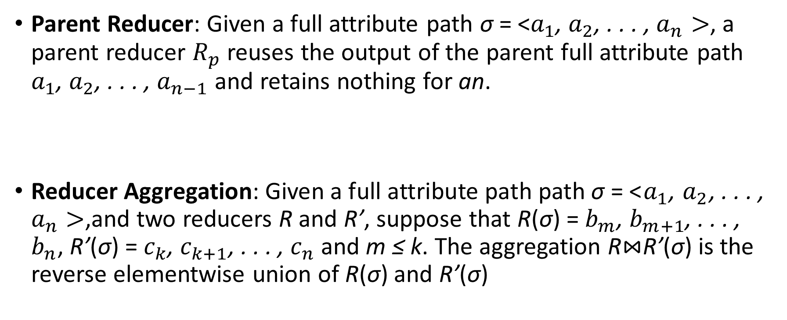
Decision Tree (Dynamic Abstraction Functions)
Parent Reducer: Given a full attribute path σ = <$a_{1}$, $a_{2}$, . . . , $a_{n}>$, a parent reducer $R_{p}$ reuses the output of the parent full attribute path $a_{1}$, $a_{2}$, . . . , $a_{n−1}$ and retains nothing for an.
Reducer Aggregation: Given a full attribute path path σ = <$a_{1}$, $a_{2}$, . . . , $a_{n}>$,and two reducers R and R’, suppose that R(σ) = $b_{m}$, $b_{m+1}$, . . . , $b_{n}$, R’(σ) = $c_{k}$, $c_{k+1}$, . . . , $c_{n}$ and m ≤ k. The aggregation R$⋈$R’(σ) is the reverse elementwise union of R(σ) and R’(σ)

Slide 19
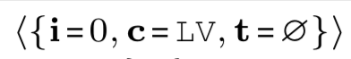

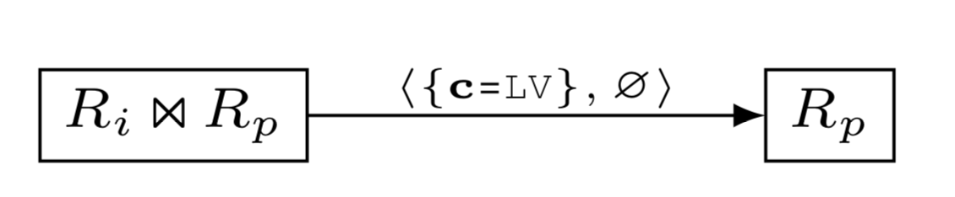
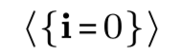
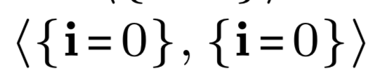
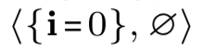
Decision Tree (Dynamic Abstraction Functions)
State abstraction function as a decision tree
Full Attribute Path
Reducer
Reducer
Reducer: function to map widget attribute path into a model widget(action)
This is a function for STOAT
Model Widget(Action)
Reduced Attribute Path
Selector
Selector: attribute path matcher
This function products model states that are too coarse-grained and lead to non-deterministic transitions
Then what?
Notes:
若是將所有小部件帶入這個決策樹，就會發現下面這些 在 ListView 中的小部件都被簡化成相同的<{i=0},0> 節點也就是會產生 nono-deterministic 的 model action
接者我們假設由這棵 decision tree 開始迭代，每一次迭代都是改變某一個節點使得 模型更加細立度或者是增加一個新的 selector 以及新的 節點來對應不同情況

Slide 20
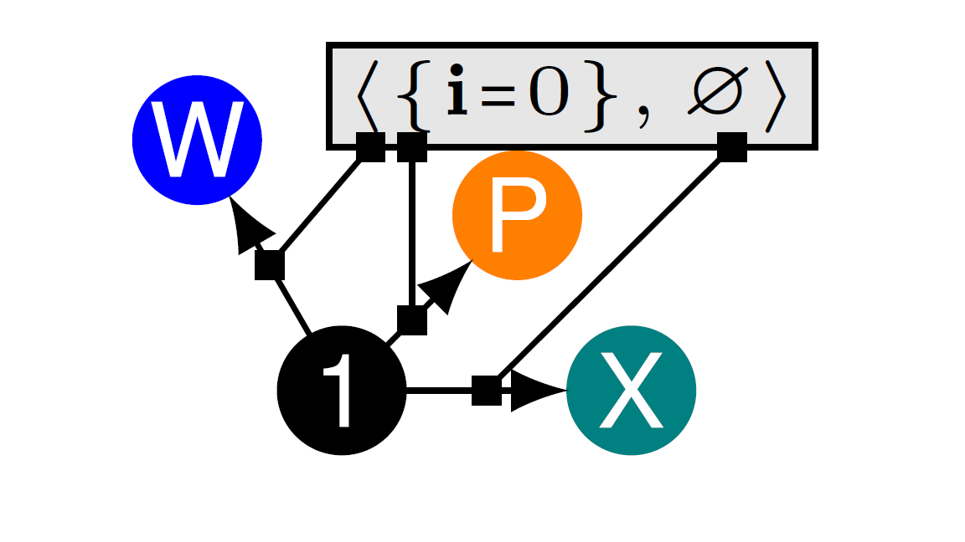
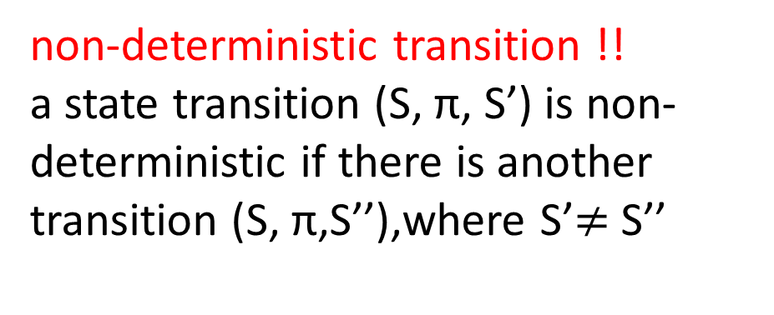
STOAT example model
Too Fine-grained
State explosion
Unnecessary UI events
Too Coarse-grained
Inaccurate test knowledge
Non-deterministic transition
non-deterministic transition !!
a state transition (S, π, S’) is non-deterministic if there is another transition (S, π,S’’),where S’$≠$ S’’
Notes:
细粒度的例子：1.直接只用Full Attribute Path; 2. index+text+parent
粒度粗的两个例子
Stoat: 在同一个GUI树中，三个GUI Action被Abstract成同一个Model Action
AMOLA: 考虑index，在两个GUI树中同一个Model Action也会状态不一致
Fine-grained: state explosion
Coarse-grained: fail to gather accurate knowledge on model actions to realize guidance/non-deterministic
What’s the appropriate granularity for an App’s GUI modeling?

Slide 21
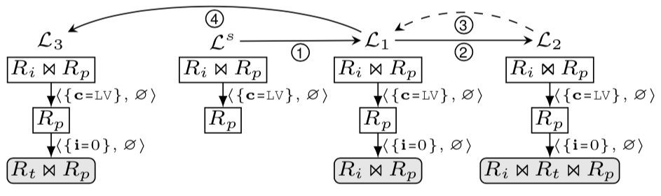
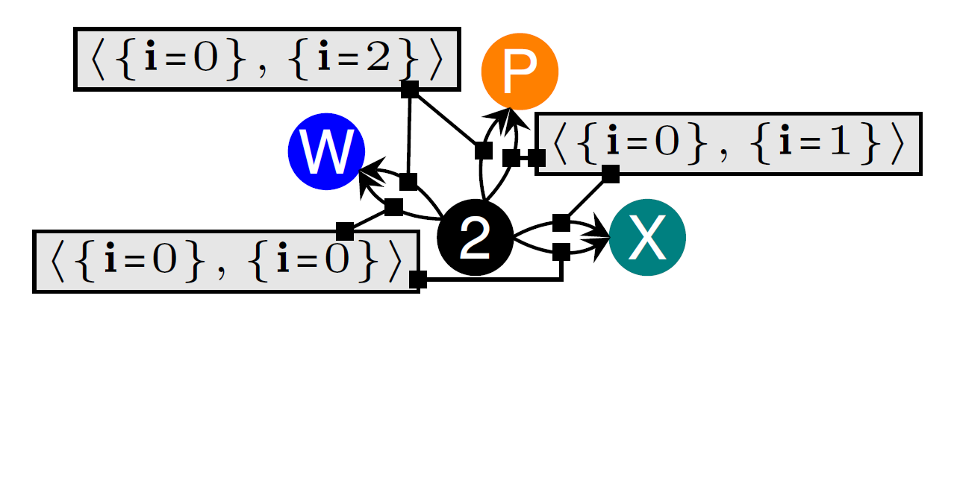
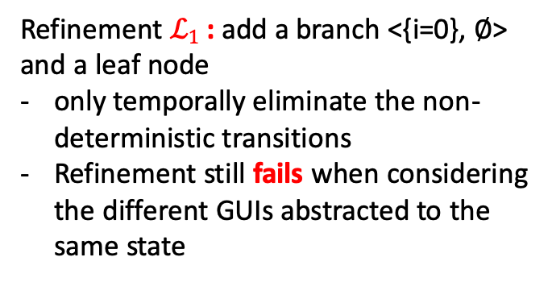
State Abstraction Refinement
Start from a default abstraction(e.g.Stoat) and refine the abstraction during test
Refinement $ℒ1$ : add a branch <{i=0}, ∅> and a leaf node
only temporally eliminate the non-deterministic transitions
Refinement still fails when considering the different GUIs abstracted to the same state
This is a function for AMOLA (C-Lv4)

Slide 22
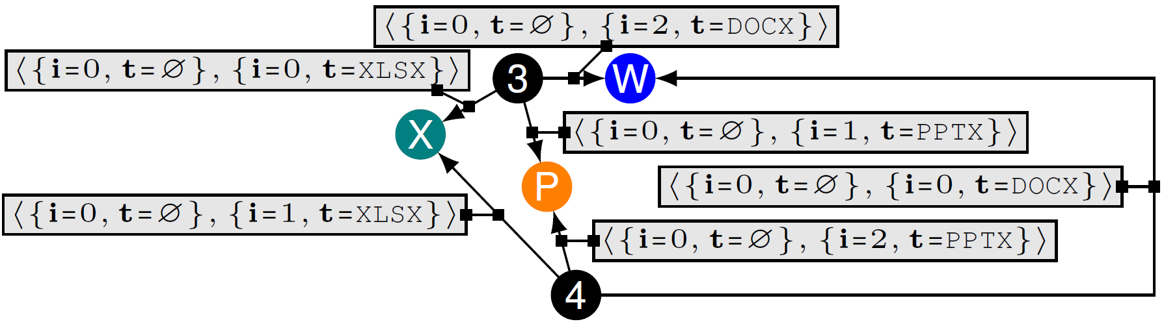

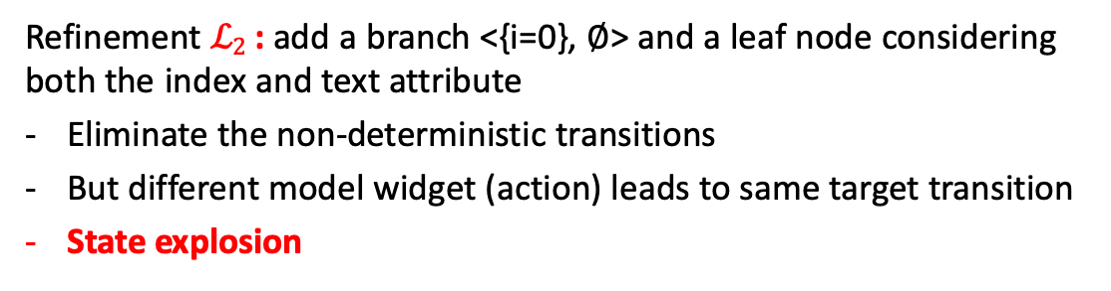

Refine again to $ℒ2$
State Coarsening: revert to the previous $ℒ1$
This is a function for AMOLA (C-Lv5)
Refinement $ℒ2$ : add a branch <{i=0}, ∅> and a leaf node considering both the index and text attribute
Eliminate the non-deterministic transitions
But different model widget (action) leads to same target transition
State explosion
Notes:
为什么是新增一个节点RI X Rp，而不是修改或者替换Rp节点

Slide 23
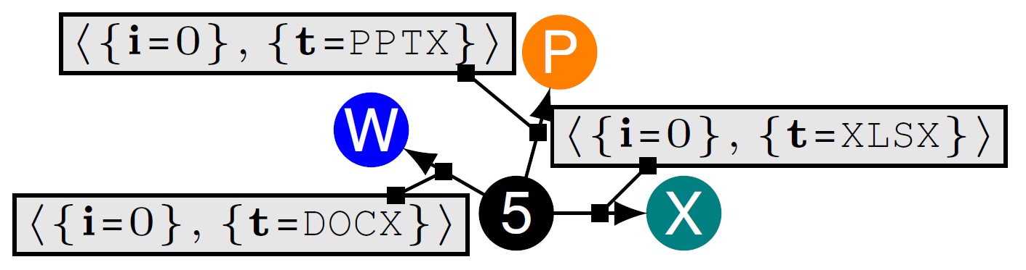

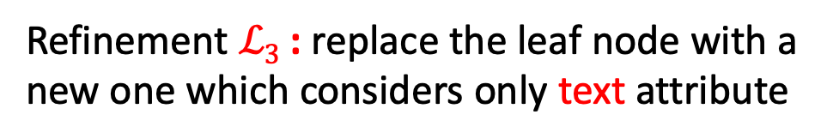
Refine again to$ℒ3$
Refinement $ℒ3$ : replace the leaf node with a new one which considers only text attribute
Notes:
通過計算新增的 state 數量發現 L2 太過細立度了，以至於容易產生狀態爆炸，對於這種情況 APE 就會檢測出來並將 L2 設為黑名單，並且回朔到狀態 L1 找尋其他更好的細立度化方法

Slide 24
APE modeling approach
State size – “Increase and decrease size when necessary”
Refinement
Coarsening
No model action abstracts more than α GUI actions in a GUI tree
No model state is refined into β new states
Instead of a static abstraction based on certain heuristics throughout the testing of an app, we propose a dynamic approach by searching for the appropriate abstraction for each app respectively.
Non-deterministic transitions should be “as few as possible”
Notes:
Refinement will replace the current abstraction function by a new one and coarsening will check whether the new abstraction function refines a state into β new states. If such cases happen, refinement will be rejected.
A model action will be refined if it
leads to non-deterministic transitions no matter what α is. The
threshold α is set to 3, which is good in practice. If α is
too large, the exploration strategy should sample each model
action more times. If α is too small, the testing tool cannot
tolerate minor differences. The threshold β is calculated based
on the number of primitive reducers of the finest reducer in
the decision tree. The largest value of β is 8 by default.

Slide 25
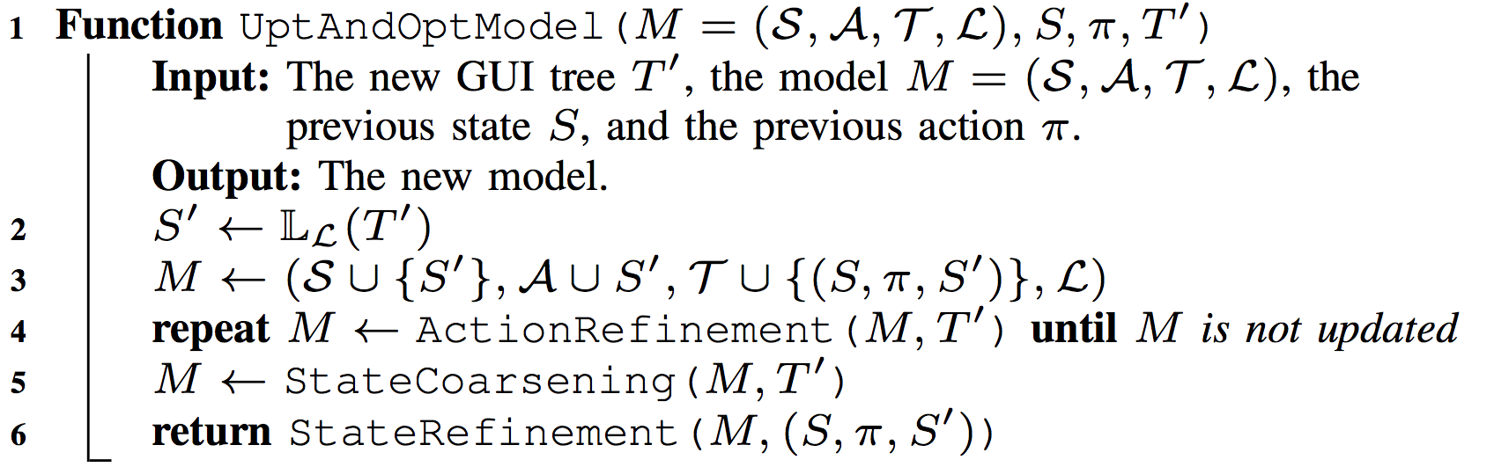
Corresponding Algorithm
No model action abstracts more than α GUI actions in a GUI tree
No model state is refined into β new states
Non-deterministic transitions should be as few as possible
Notes:
衍生出來的算法相對來說每一次迭代都有有三件主要的事情必須完成

Slide 26
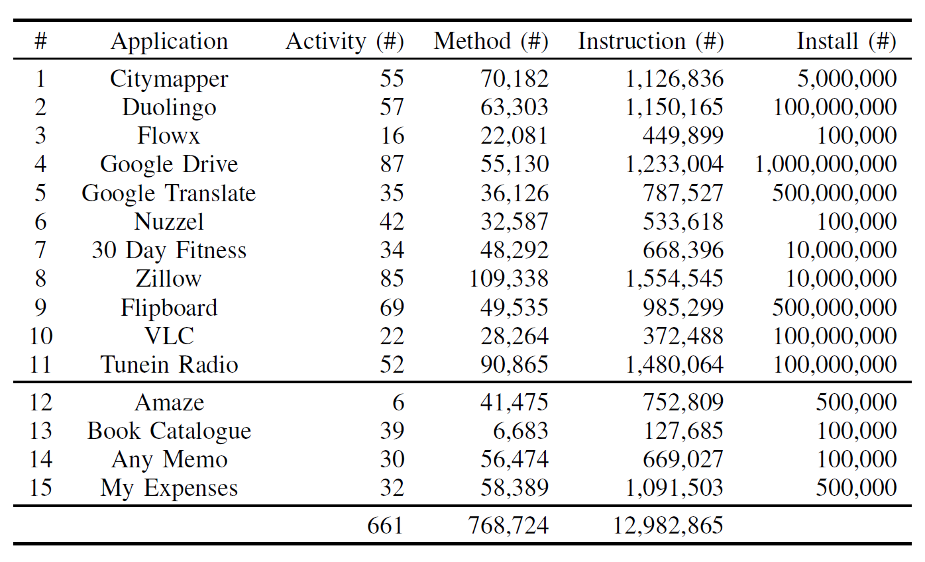
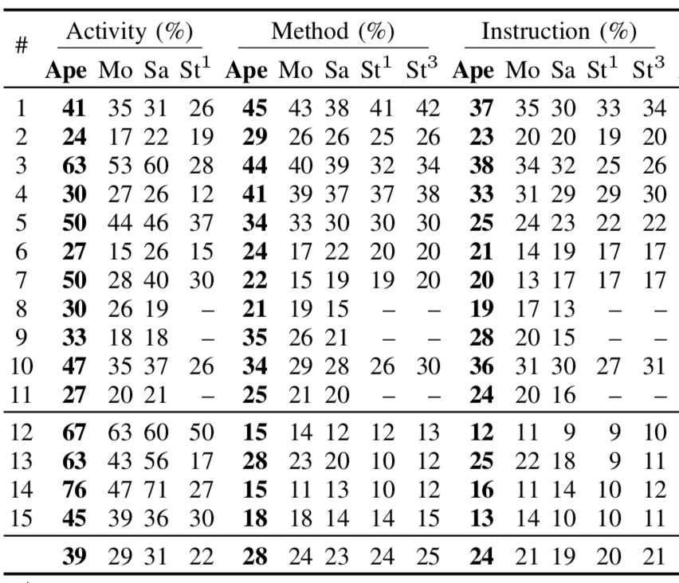
Result - Coverage
APE consistently resulted in
26– 78%, 17–22% and 14–26%
relatively improvements over
the other three tools
in terms of coverage
Notes:
这主要是大部分Android app都是做简单的UI操作，主要的计算都是在服务端，但是根据一些用户反馈，ape还是比较快速的提升coverage的。
we first randomly selected 11 apps from the editor’s
choice collection of the Google Play Store,2 where four
apps were also used by [21]. Second, we randomly selected
another four well-maintained (i.e., updated since 2017) opensource
benchmark apps used by SAPIENZ and STOAT.
APE and Monkey => android 6
SAPIEZ, STOAT => android 4.4
每一種測試工具對每一個 app 測試一個小時，STOAT 除外，STOAT 則是使用他們官方最新的設定 用一小時建立模型，兩小時測試

Slide 27
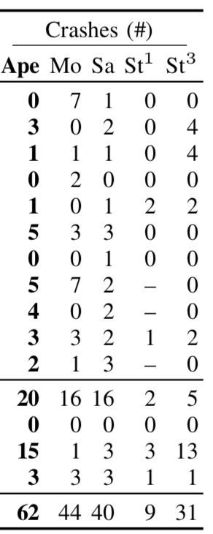
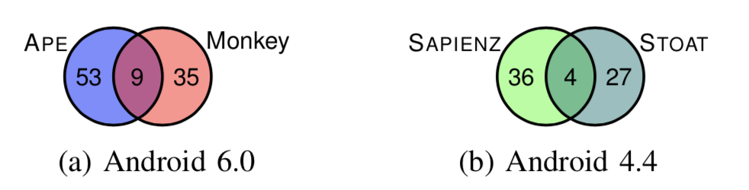
Result - Crashes
APE detected 62 crashes,
while Monkey detected 44,
SAPIENZ 40, and STOAT 31
Unique Crashes
Notes:
我们主要是通过unique normalized stack trace，也就是Java异常stack trace里的message被移除了，只考虑异常类型，方法，行号这些信息。
We do not compare crashes detected by tools on different versions of Android via normalized stack traces because different versions of Android have different Android framework code.
以上表示的錯誤種類是將多於不相關的訊息(process pid 或 error message)去掉以後形成的錯誤種類圖

Slide 28
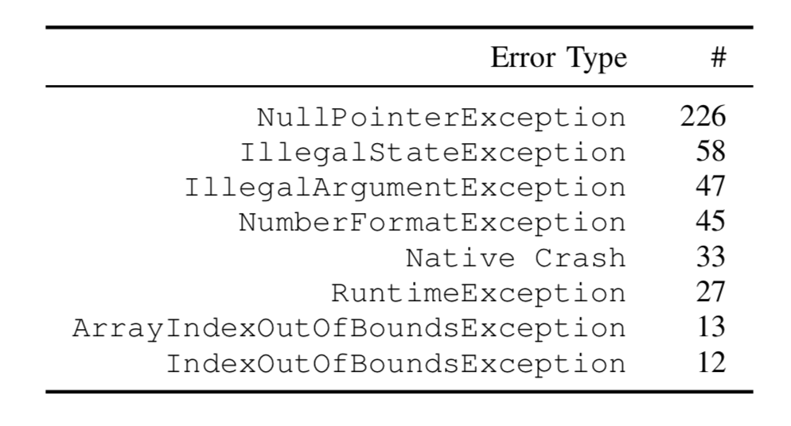
Large-Scale Evaluation
1,316 apps from the Google Play Store for 30 minutes each
537 unique crashes detected in 42 error types from 281 of 1,316 apps
38 crashes reported to developers with steps to reproduce the crashes, where 13 have already been fixed, and 5 have been accepted (fixes pending).
Notes:
對於圖表上面的結果只表示多於 10 個 crashes 的種類，並且也不考慮只出現在特殊第三方手機(Samsung)或模擬器上面的 crashes

Slide 29
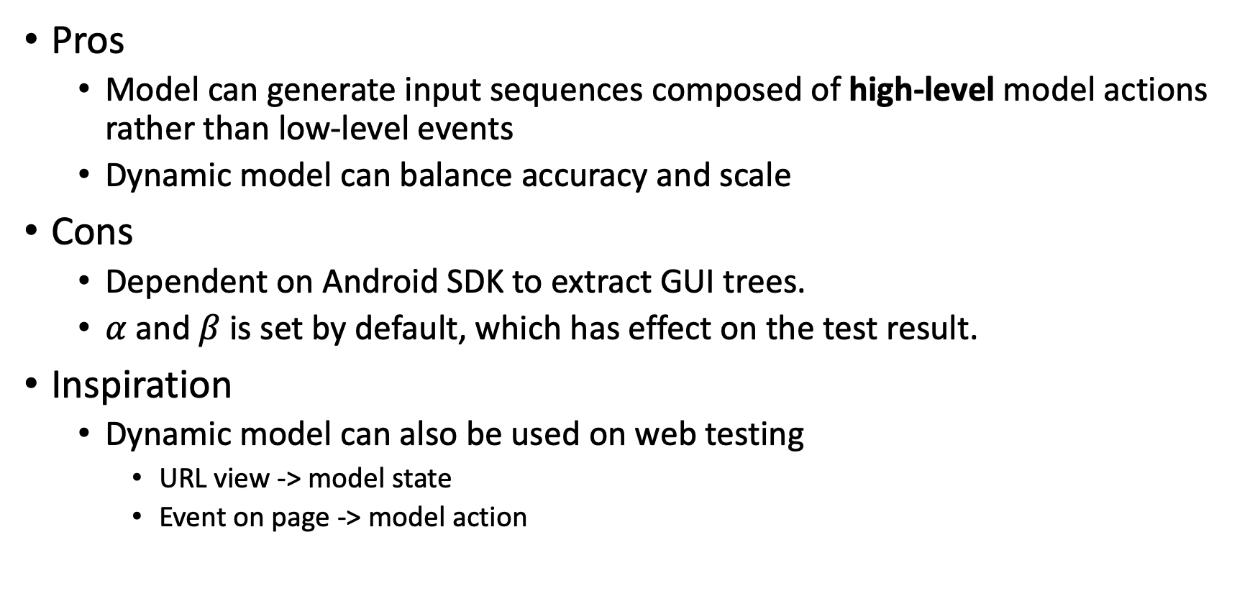
Summary
Pros
Model can generate input sequences composed of high-level model actions rather than low-level events
Dynamic model can balance accuracy and scale
Cons
Dependent on Android SDK to extract GUI trees.
$α$ and$β$ is set by default, which has effect on the test result.
Inspiration
Dynamic model can also be used on web testing
URL view -> model state
Event on page -> model action
Notes:
对于本文的优点，首先，文中使用的基于模型的测试方法更加科学，模型可以生成一些测试用例，来引导程序的开发和调试。而且模型生成的测试动作相比于人为生成的测试动作更高级的，因为模型对GUI的动作进行了抽象，减小了动作的冗余。
其次，本文创新的提出了动态的模型，可以在测试过程中，不断调整模型抽象的粒度，使得生成的模型即控制了规模，又可以保证自己的高精度，使生成的测试事件尽可能的覆盖测试范围。
而对于本文的缺点，本文提出的方法有一定的局限性，依赖安卓API抽取GUI树，只适用于一些GUI的简单操作，比如点击事件、滑动事件等等，对于GUI组件内部的一些复杂操作，测试会有遗漏，比如视频组件VideoView，可能视频中的一些功能是嵌入到内部的，安卓API生成的GUI树仅能细化到视频组件。
论文中的$α和β$参数都是预先定义的，不同应用这个参数需要设置不同的数值，不同数值可能会对测试结果产生影响。
最近在实验室做一个关于物联网视频分析与管理系统，我主要是负责其中的前端工作，我觉得这个基于安卓的GUI测试方法同样适用于前端界面的测试，不同的URL界面可以抽象成模型状态，在前端上的不同操作动作可以抽象成模型动作，进而实现基于模型的自动化动态测试。不过，对于GUI树的提取需要自己实现，不像安卓封装了API接口那么便捷，同时，前端界面的布局等等比安卓界面要复杂得多，在模型的粗细粒度控制方面需要进一步优化。

